Slide 1
VSCode Plugin Development for Automotive App Deployment
Software Engineering Project – Team Bosch.IO
Leipzig, 28.09.2023
Maximilian Nerlich, Carlo Pötter, Martin Hoffmann & Leonardo d‘Angelico

Slide 2
PROJECT OUTLINE – SETUP, GOALS & OUTCOME
Team Bosch.IO

Slide 3


SETUP: PARTIES & INTERACTION
Software Engineering Project | Team Bosch.IO
SEP PROJECT
TEAM
Eclipse Foundation as industry open source incubator
Industry standards & hub for strategic open source innovation
Embraced by industry leaders (like e.g. Bosch.IO)
Carries Eclipse IDE, Jakarta EE (Java ecosystem) & 400+ open source projects
Notes:
=> We interact with Bosch.IO

Slide 4


SETUP: PARTIES & INTERACTION
Software Engineering Project | Team Bosch.IO
SEP PROJECT
TEAM
Bosch.IO as mediator between SEP project team (us 4) & Eclipse Foundation
open source collaboration
Role: mentoring, project mediation, tech. guidance
Dr. Kristan: direct contact person & PO
M. Grzanna = Tech. assistance
Notes:
=> We interact with Bosch.IO

Slide 5
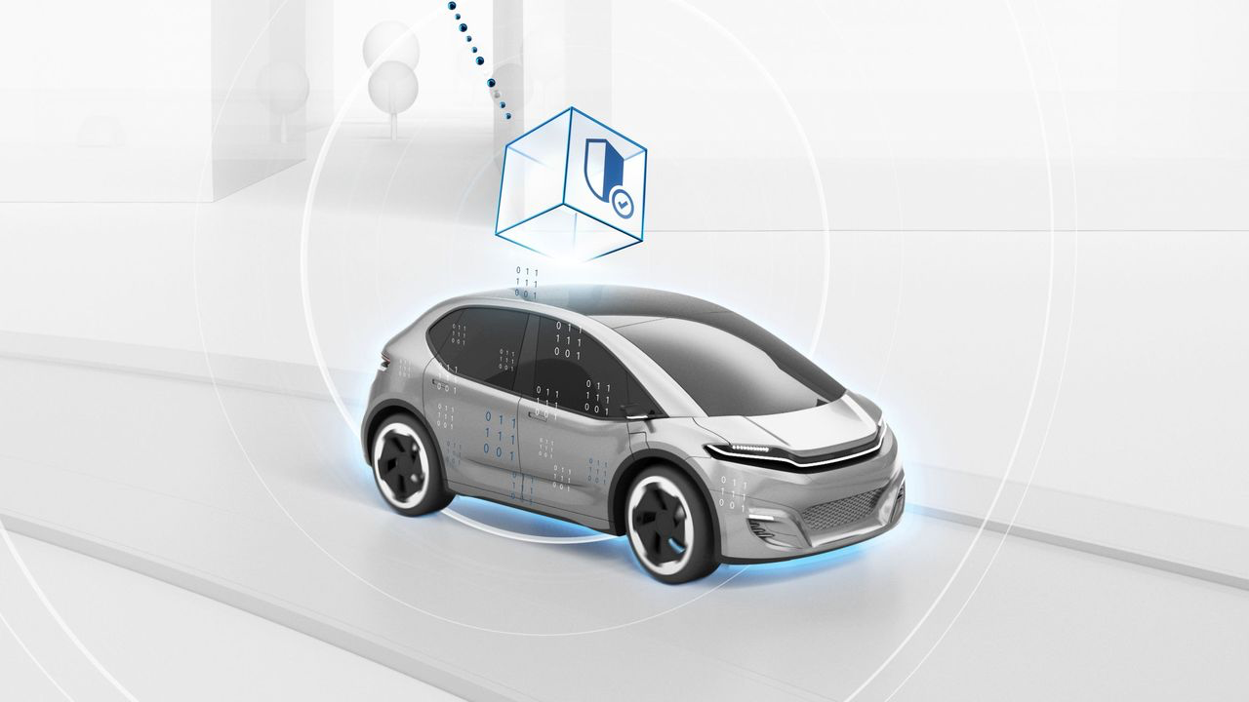
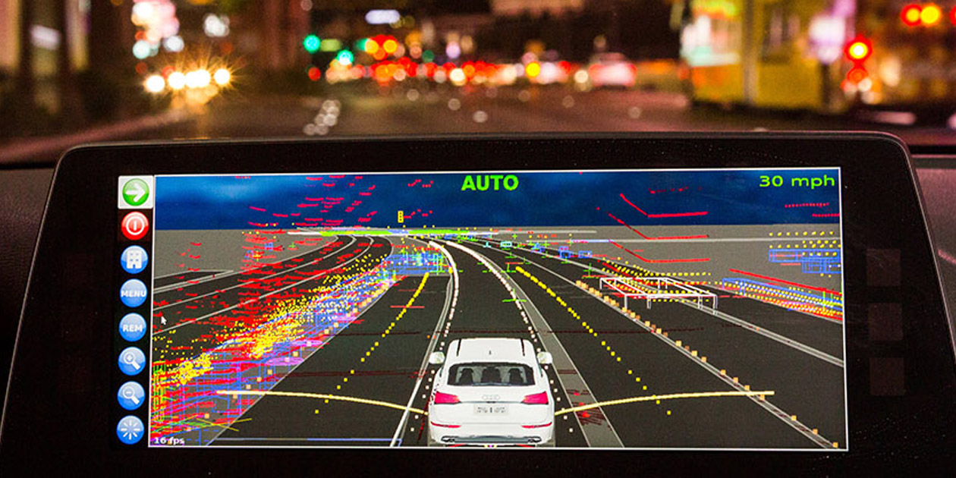


One of 4oo Projects: WHERE WE Contribute
Software Engineering Project | Team Bosch.IO
ECLIPSE LEDA = Technology ecosystem for Software-Defined-Vehicles (SDV)
Aims to bring various SDV-components together in optimization
Linux distribution (OS) with tool stack to deploy apps on vehicles
Perspective: vehicles as „computer“:
vehicle app
deploy
run
Notes:
1 of 400+ Projects
EXAMPLES:
- Lane-Keeping-Assistent,
-. Collision Detection,
or Sear-Adjuster,

Slide 6
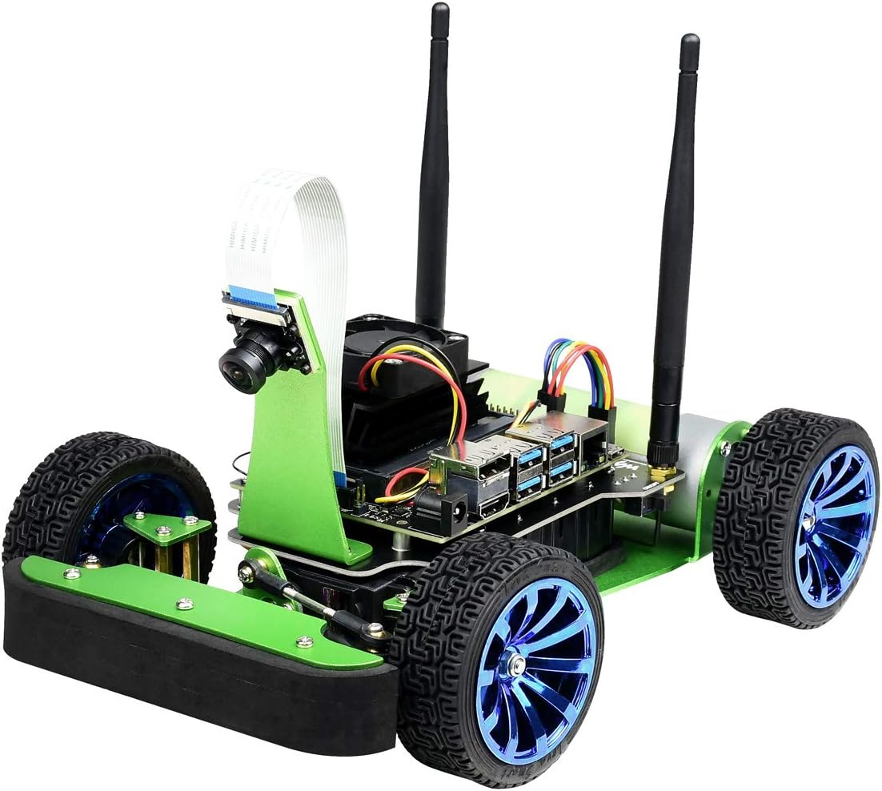



THE PROJECT GOALS
Software Engineering Project | Team Bosch.IO
A
B
C
A. Reshape inefficient „traditional“ deployment process.
Melt new deployment process into VSCode plugin.
Test hardware & VSCode plugin on Jetson Nano („Racer“) that runs Leda.

Slide 7
PROBLEM
Software Engineering Project | Team Bosch.IO
TWO INEFFICIENCIES IN „TRADITIONAL“ SDV DEPLOYMENT PROCESS
manuel configuration on vehicle (via SSH)
multiple dependencies
time overhead
advanced Infrastructure knowledge needed
internet
error-intense
remote build tools
Notes:
Problem with internet: On field (e.g. testing outside), there might be no (sufficient) internet connection

Slide 8
SOLUTION
Software Engineering Project | Team Bosch.IO
VSCODE PLUGIN TO EASE TRIGGERING A NEW DEPLOYMENT PROCESS
manual configuration on vehicle (via SSH)
solution
deployment in IDE via VSCode plugin
reshaped process, internalizing container-build (no internet connection required)
solution
multiple dependencies

Slide 9

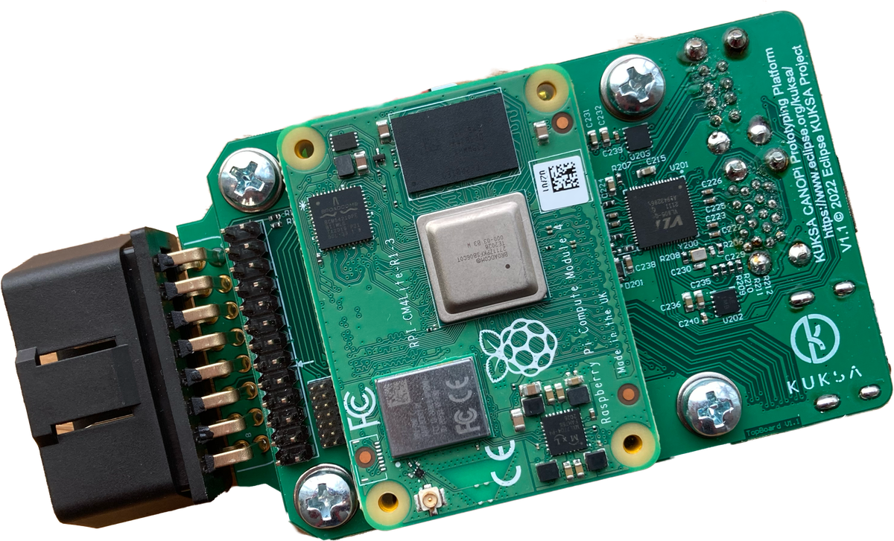




OUR DEPLOYMENT PROCESS VIA VSCODE PLUGIN
Development Flow Today
5. Download container image
MQTT
Software Engineering Project | Team Bosch.IO
2. build image
local
vehicle app
4. start container
1. develop in-vehicle-app
3. copy image via local network
Notes:
A developer (call her “Jane“) develops a Vehicle Application in VSCode
In VSCode, our Plugin is installed (see „Target“ Symbol)
With one simple click: Our Plugin will trigger a local Container-build via Docker
Then, it will automatically copy this image on Vehicle (via local network)
Eclipse Leda then starts the container and it runs
➔ Jane can easily alter some code and with one click, the app on the vehicle changes in seconds

Slide 10

FOR GOOD MEASURE: THE “TRADITIONAL“ PROCESS
Development Flow Today
5. Download container image
MQTT
Software Engineering Project | Team Bosch.IO
3. GitHub Actions pipeline (remote)
2. push code
vehicle app
5. pull image (from remote)
6. start container
1. develop in-vehicle-app
4. manual alter config (SSH)
Notes:
Lets just quickly recap the traditional deployment process for good measure:
You see in the traditional process, that
GitHub is involved -> this requires Internet which she might not have on field
Lower red arrow: She has to go on the device every time she alters code! ➔ We have optimized the process.

Slide 11
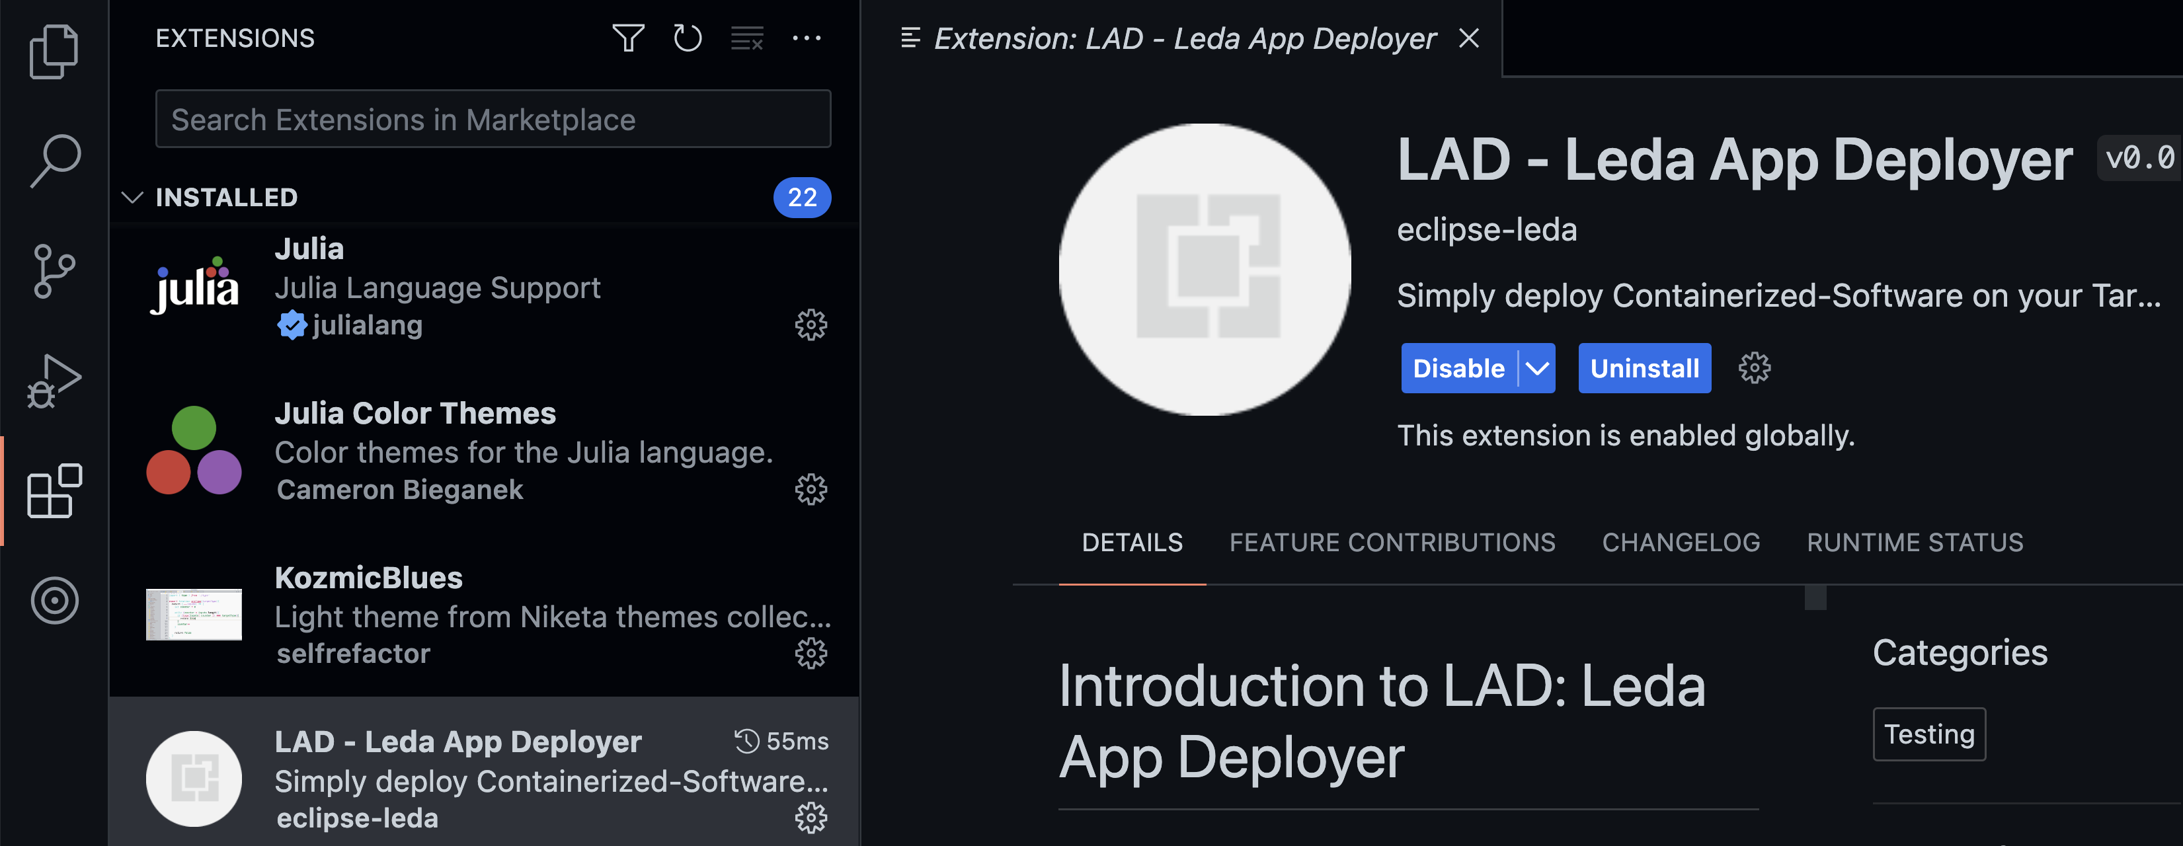



THE PLUGIN: LEDA APP DEPLOYER (LAD)
Software Engineering Project | Team Bosch.IO
Notes:
Lets open VSCode: This is out Plugin (the so called LAD: Leda App Deployer) in the VSCode Extension Menu
Down there, our LAD is located
On the left, you notice a „target“ symbol. From here, we can go into the plugin directly

Slide 12
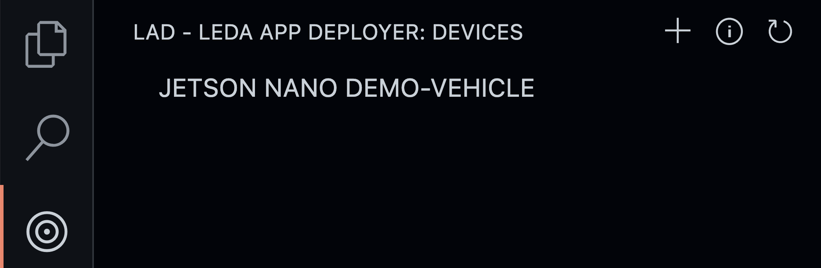

LAD IN ACTION
Software Engineering Project | Team Bosch.IO
trigger process
Notes:
Here, I have clicked on this target:
The minimalistic plugin UI opens.
You see a little Icon-Bar on the right.
I wont go into detail on every button here but the most important one is the little „Paper with an Arrow on it“
Jane can now trigger the new deployment process I‘ve shown you with one click directly in the IDE!

Slide 13


PROJECT OUTCOME & DEVIATION
Software Engineering Project | Team Bosch.IO
Leda is not running on Jetson Nano ARM64
A
B
C
➔ Deviation: We could still run tests with virtualization on VM
Notes:
So lets summarize our outcome:
A: We have reshaped the traditional process to remove dependencies from GitHub or Internet connection → Check.
B: We have successfully developed a Plugin to trigger the proces
…Check
C: Now we wanted to test this by deploying software on our little racer (you see here)
… This was not possible! -> Leda does not run on this processor Type
➔ There is an Open PR on Leda Organization for this Problem (typical incubating software problem in open source projects)
BUT: We could still run tests with a Virtual Vehicle Environment → So this is technically also fulfilled.

Slide 14
PROJECT MANAGEMENT – ONBOARDING, FRAMEWORK & TOOLS
Team Bosch.IO

Slide 15




ONBOARDING WITH BOSCH.IO
Software Engineering Project | Team Bosch.IO
DEFINE PROJECT FRAME & SELECT PROJECT MANANGEMENT TOOLSTACK
Support from Bosch.IO:
Clarification of project insights (as shown)
Communication of required skills & technical guidance
Contact to Leda developers (Eclipse Foundation)
Definition of our communication & project management tool stack
Define SCRUM as framework & adapt it to our needs
Notes:
- Team Model Canvas:
- Strength, Weaknesses
- Goals, Expected Outcome
- Value we create. = WORKS GOOD FOR TEAM BUILIDING
TOOLS:
- DISCORD: Main communication channel ➔ Good: Screenshare (Pair-Programming) and Chat
- MS-Teams: Communication Bosch.IO-related ➔ Used because: it is their company communication service
- Confluence: Where we store our Documentation ➔ Used as free WIKI
- GitHub:
- ISSUES: Track our SCRUM-Related things in a Board (present later on)

Slide 16
PROJECT MANAGEMENT VIA SCRUM
Software Engineering Project | Team Bosch.IO
Roles
PO
Dev Team
Scrum Master
Artifacts
Product Backlog
Sprint Backlog
Product Increment
Events
Sprint
Sprint Planning
Daily Scrum
Sprint Review
Sprint Retro
Refinement

Slide 17
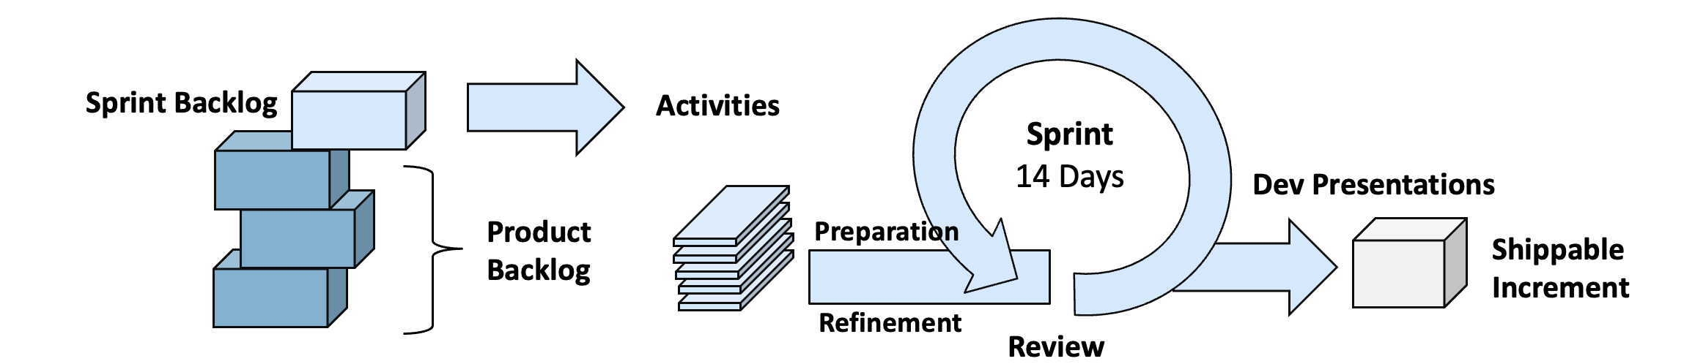
SCRUM „LITE“ – OUR ADAPTION & ROLE DISTRIBUTION
Software Engineering Project | Team Bosch.IO
Roles
PO (Dr. Kristan)
Dev Team (all 4)
Scrum Master (M. Nerlich)
Artifacts
Product Backlog
Sprint Backlog
Product Increment
Events
Sprint
Sprint Planning
Daily Scrum
Sprint Review
(Sprint Retro)
+ Preparation Sessions
Refinement
Notes:
Deviation:
- Roles: Dev Team is everyone (SM and the others)
- Events:
- NO Daily ➔ Time-Constraints
- Stringly Reduced Retro, we combined with Sprint Planning ➔ Not that important: Good Sentiment overall, problems tackled in Review)
- BUT Prep Sessions every week before Scrum Meetings ➔ Necessary to keep sync, for SEP-Monday-Presentation
- BUT Presentations for Leda Team (Necessary)
➔ Mentioning: Monday-Presentation-SEP, Dev-Meetings Eclipse (Irregular)
➔ Overall: We kept out basic routines
@ After the flow appeared @
- INTERACTIONS ➔ We in Team (Pair Programming, Discord, Live Coding together)
We with Johannes in Sprint Planning, Review
We with other Devs from Leda in Dev Presentation)
-

Slide 18
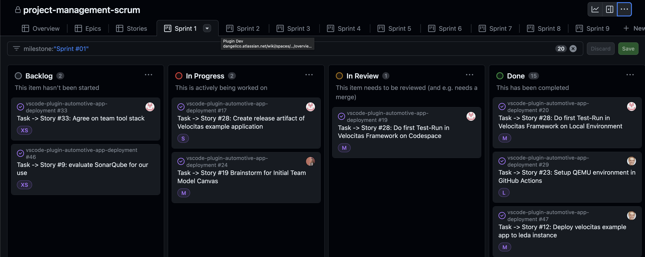
MANAGE SCRUM WITH GITHUB ISSUES BOARD
Software Engineering Project | Team Bosch.IO
Notes:
The good:
Already in our Dev-Environment
Linking Pull Requests to Tickets
We all have already accounts in GitHub
Free
The bad:
Not tailored for Scrum
E.g. No explicit Subdivision from Epics -> Stories -> Tasks,
Solution: See board (Linking via Labels (Epics) and Naming

Slide 19
DEVELOPMENT – WORKFLOW & TYPICAL ISSUES
Team Bosch.IO

Slide 20
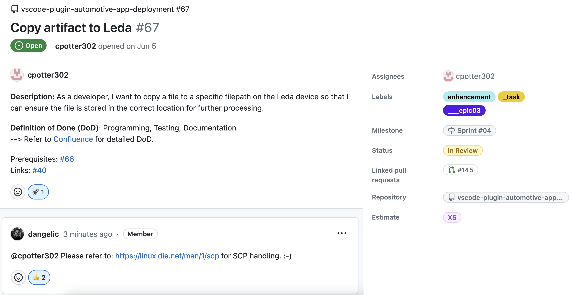
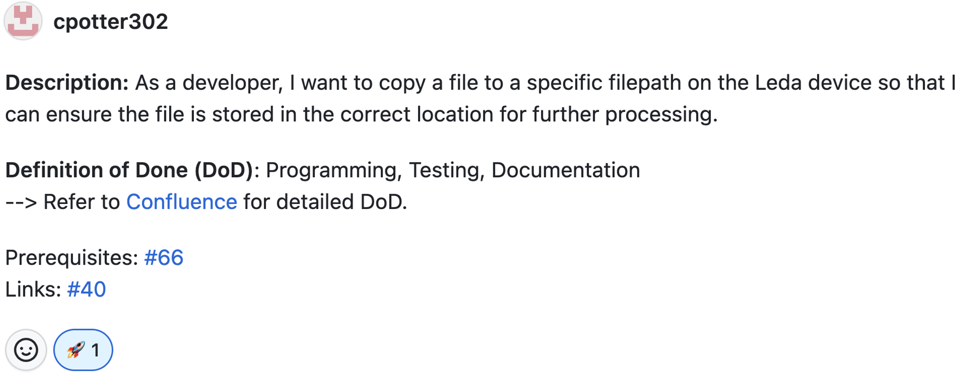
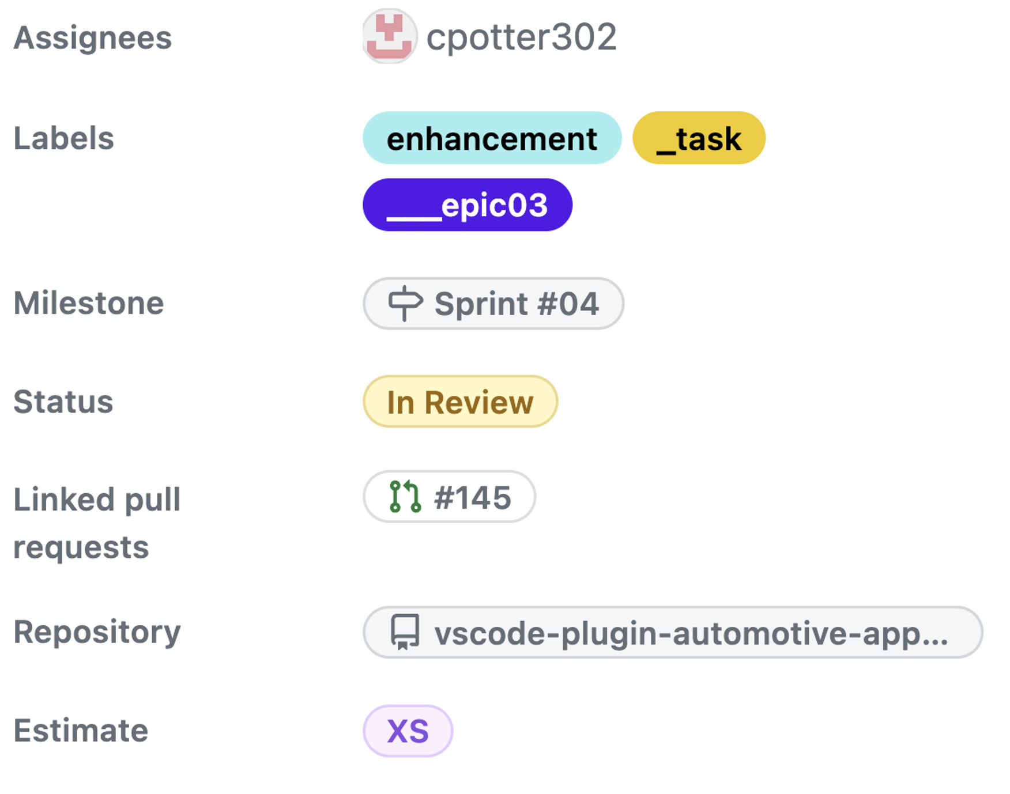
Software Engineering Project | Team Bosch.IO
Task -> Story #22 Copy Artifact to Leda #67
Code Quality
Notes:
Linked Pull request => traceabilty of issues

Slide 21


OUR IDEAL DEVELOPMENT WORKFLOW
Software Engineering Project | Team Bosch.IO
write ticket (board)
sight ticket
implement & test feature
commit & push
trigger
GitHub- Actions
open PR
review PR
merge PR

Slide 22
TYPICAL ISSUES
Software Engineering Project | Team Bosch.IO
implement & test feature
DEVIATION FROM OPTIMAL PROCESS
Ticket definition & communication issues
Ticket is vagely defined
Estimation not precise enough
Long review phases (for PR)
Technical issues
Fail of tests or build pipeline
Merge Conflicts
Bad reviews → Bugs on master branch
Feature is not implementable
trigger
GitHub- Actions
write ticket
review PR
merge PR

Slide 23


DEVELOPMENT TOOL LANDSCAPE
Software Engineering Project | Team Bosch.IO
Emulates Leda (OS)
Container engine
Virtualization of vehicle
Configuration management
Code editor / IDE
Code version management
Unit testing
Release-pipeline & management
DEV-suite for VSCode plugin
Actions: build-test-pipeline

Slide 24
PROJECT SUM UP – BIGGEST CHALLeNGE, HIGHLIGHT & KEY LEARNINGS
Team Bosch.IO

Slide 25

BIGGEST Challenge: BECOME PROJECT-COMPLIENT
Software Engineering Project | Team Bosch.IO
COMPLIENCE FOR THE LEDA OPEN SOURCE CONTRIBUTION
Code compliance
… be a repository under project Leda
Legal compliance
Notes:
Now I want to go on with out biggest Challange: Getting Complient for the Open Source Contribution
You see, we have developed our Plugin successfully. Now we want to be a repository in Leda Projects (that runs under Eclipse Foundation)
We have two obstacles in our way: a) Code Compliance
b) And Legal Complicance
I will show you in detail what this means:

Slide 26
BIGGEST Challenge: BECOME PROJECT-COMPLIENT
Software Engineering Project | Team Bosch.IO
CODE compliance: source code has to follow specific project standards.
code quality
style conventions
security standards
maintainability
✓ Refactor to TS clean-code guidelines
✓ Use OOP-design principles, separate duties
✓ Use formatter, linter & pre-commit-hooks
✓ Emphasize code documentation & readme
✓ Install dependency weakness checker
✓ Seek help: Get reviews from PO
Notes:
CODE QUALITY: Language Best Practices, KISS,
STYLE CONVENTION: Naming Conventions, Consistent Formatting
SECURITY STANDARDS: Safe Dependencies and Libraries, Security Design Patterns
MAINTAINABILITY: Important because other contributors must understand the logic

Slide 27
BIGGEST Challenge: BECOME PROJECT-COMPLIENT
Software Engineering Project | Team Bosch.IO
LEGAL compliance: code has to follow open source licensing guidelines.
software licensing
dependency licences
legal document stack
contribution license agreement
✓ Get familiar with Apache 2.0 and MIT
✓ Sight & implement project rules
✓ Replace / remove incomplient libraries
✓ Use related Leda repos as blueprint
✓ Request dependency scan by Eclipse
✓ Seek help: Get help from PO

Slide 28
BIGGEST HIGHLIGHT: WE WILL BE PART OF LEDA
Software Engineering Project | Team Bosch.IO
… AND THE PROJECT DOES NOT END HERE FOR US
SDV as future-proven domain
We simplify SDV development
But plugin not tested on Field
Further development required ➔ We keep Maintaining!
Code compliance
Legal compliance

Slide 29


KEY LEARNINGS & PROJECT SUM UP
Software Engineering Project | Team Bosch.IO
WE COULD ALL ENHANCE OUR SKILLSET IN THIS PROJECT
Technical perspective
SDV-development & toolstack (Leda environment)
Working in incubating hightech project
Development of VSCode plugin
Project management perspective
Collaborative toolstack on GitHub
Most important: Team & time Management
The open source perspective
Code guidelines
Most unexpected: Various legal guidelines & processes
Notes:
* INCUBATING: We learned that some crucial dependencies might not work: Workarond (e.g. Racer Emulation QEMU

Slide 30
Team Bosch.IO THANKS FOR YOUR the attention! – Q&A
Maximilian Nerlich, Carlo Pötter, Martin Hoffmann & Leonardo d‘Angelico
M.Sc. Business Information Systems
https://github.com/software-engineering-project-org

Slide 31
Image sources
Software Engineering Project | Team Bosch.IO
LAST RETRIEVED: 26.09.2023
Eclipse Foundation: https://upload.wikimedia.org/wikipedia/commons/thumb/7/79/Eclipse_Foundation_Logo.svg/1200px-Eclipse_Foundation_Logo.svg.png
Eclipse Leda: https://projects.eclipse.org/sites/default/files/logo_02_rgb.png
VSCode: https://upload.wikimedia.org/wikipedia/commons/thumb/9/9a/Visual_Studio_Code_1.35_icon.svg/2048px-Visual_Studio_Code_1.35_icon.svg.png
Docker: https://w7.pngwing.com/pngs/991/165/png-transparent-docker-hd-logo-thumbnail.png
Discord: https://assets-global.website-files.com/6257adef93867e50d84d30e2/636e0b52aa9e99b832574a53_full_logo_blurple_RGB.png
Microsoft Teams: https://static.wixstatic.com/media/fffeb7_1fe7b9d7f11248f8a592fe28c9ea3710~mv2.png/v1/fill/w_956,h_250,al_c,lg_1,q_85,enc_auto/ms-teams-logo.png
Confluence: https://upload.wikimedia.org/wikipedia/commons/thumb/8/88/Atlassian_Confluence_2017_logo.svg/2560px-Atlassian_Confluence_2017_logo.svg.png
GitHub: https://1000logos.net/wp-content/uploads/2021/05/GitHub-logo.png
DrawIO: https://upload.wikimedia.org/wikipedia/commons/thumb/3/3e/Diagrams.net_Logo.svg/2048px-Diagrams.net_Logo.svg.png
Qemu: https://upload.wikimedia.org/wikipedia/commons/thumb/4/45/Qemu_logo.svg/2560px-Qemu_logo.svg.png

